Slide 1
Smt. S R Patel Engineering College, Dabhi
Cover page of Lecture Notes
Faculty Name: Himanshu Khurana
Branch: CE Semester: 5th Name of Subject: OOPJ (2150704)
Chapter/ Unit No. | Introduction to Object orientation, Modeling as a Design Technique
11 | Topics:( as per the lesson planning) Modeling Concepts ,abstraction, The three models, Class Model, State model and Interaction model.

Slide 2
What is UML?
Unified Modeling Language
  OMG Standard, Object Management Group
  Based on work from Booch, Rumbaugh, Jacobson
UML is a modeling language to express and design documents, software
  Particularly useful for OO design
  Not a process, but some have been proposed using UML
  Independent of implementation language

Slide 3
Why use UML
Open Standard, Graphical notation for
  Specifying, visualizing, constructing, and documenting software systems
Language can be used from general initial design to very specific detailed design across the entire software development lifecycle
Increase understanding/communication of product to customers and developers
Support for diverse application areas
Support for UML in many software packages today (e.g. Rational, plugins for popular IDE’s like NetBeans, Eclipse)
Based upon experience and needs of the user community

Slide 4
Brief History
Inundated with methodologies in early 90’s
  Booch, Jacobson, Yourden, Rumbaugh
Booch, Jacobson merged methods 1994
Rumbaugh joined 1995
1997 UML 1.1 from OMG includes input from others, e.g. Yourden
UML v2.0 current version

Slide 5
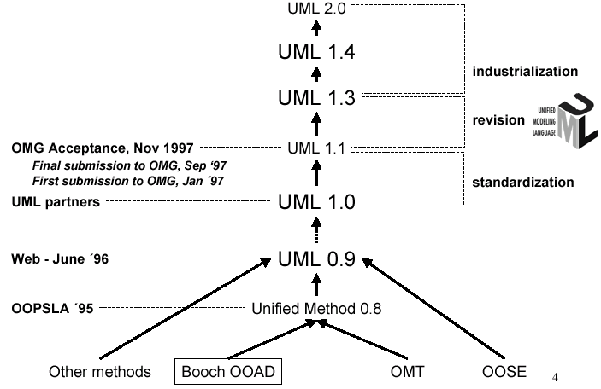
History of UML

Slide 6
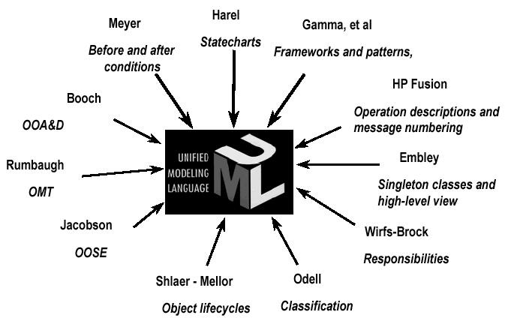
Contributions to UML

Slide 7
Systems, Models and Views
A model is an abstraction describing a subset of a system
A view depicts selected aspects of a model
A notation is a set of graphical or textual rules for depicting views
Views and models of a single system may overlap each other
Examples:
System: Aircraft
Models: Flight simulator, scale model
Views: All blueprints, electrical wiring, fuel system

Slide 8
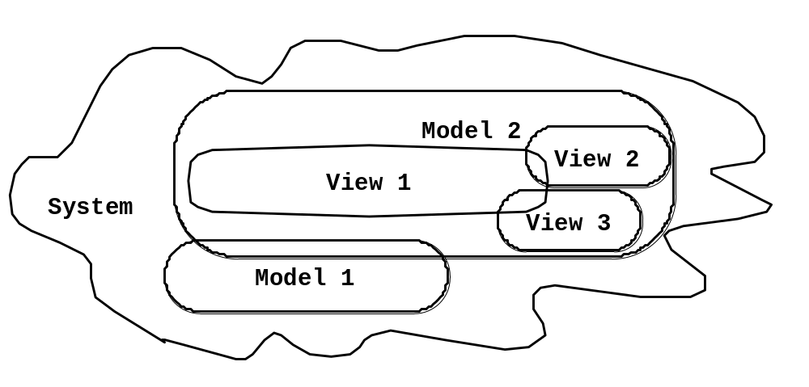
Systems, Models and Views
Flightsimulator
Blueprints
Aircraft
Electrical
Wiring
Scale Model

Slide 9
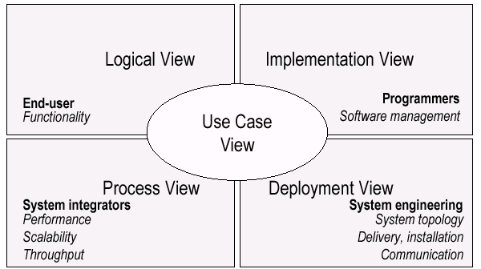
UML Models, Views, Diagrams
UML is a multi-diagrammatic language
  Each diagram is a view into a model
    Diagram presented from the aspect of a particular stakeholder
    Provides a partial representation of the system
    Is semantically consistent with other views
  Example views

Slide 10
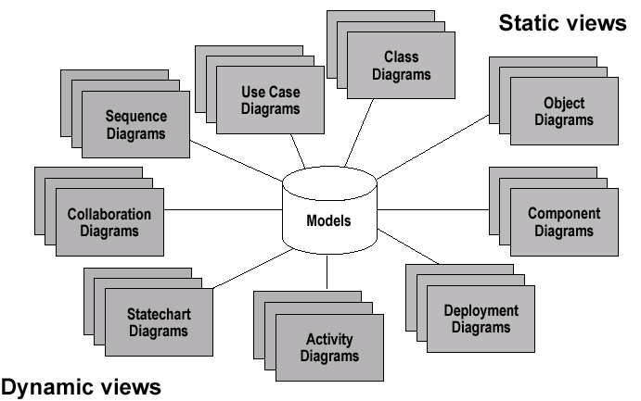
Models, Views, Diagrams

Slide 11
How Many Views?
Views should to fit the context
  Not all systems require all views
  Single processor: drop deployment view
  Single process: drop process view
  Very small program: drop implementation view
A system might need additional views
  Data view, security view, …

Slide 12
UML: First Pass
You can model 80% of most problems by using about 20 % UML
We only cover the 20% here

Slide 13
Basic Modeling Steps
Use Cases
  Capture requirements
Domain Model
  Capture process, key classes
Design Model
  Capture details and behaviors of use cases and domain objects
  Add classes that do the work and define the architecture

